Slide 1


Slide 2
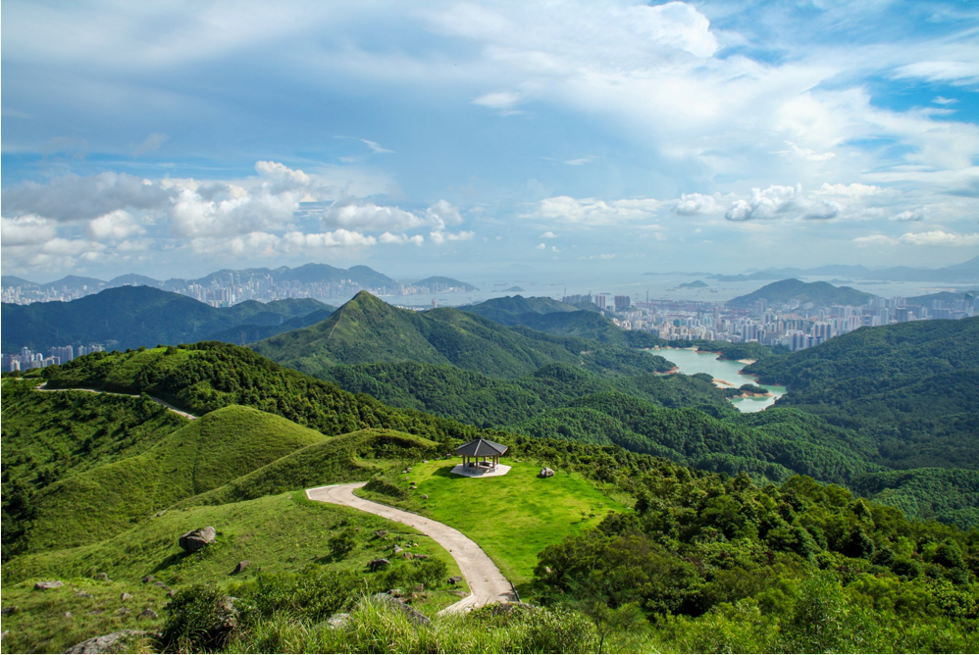
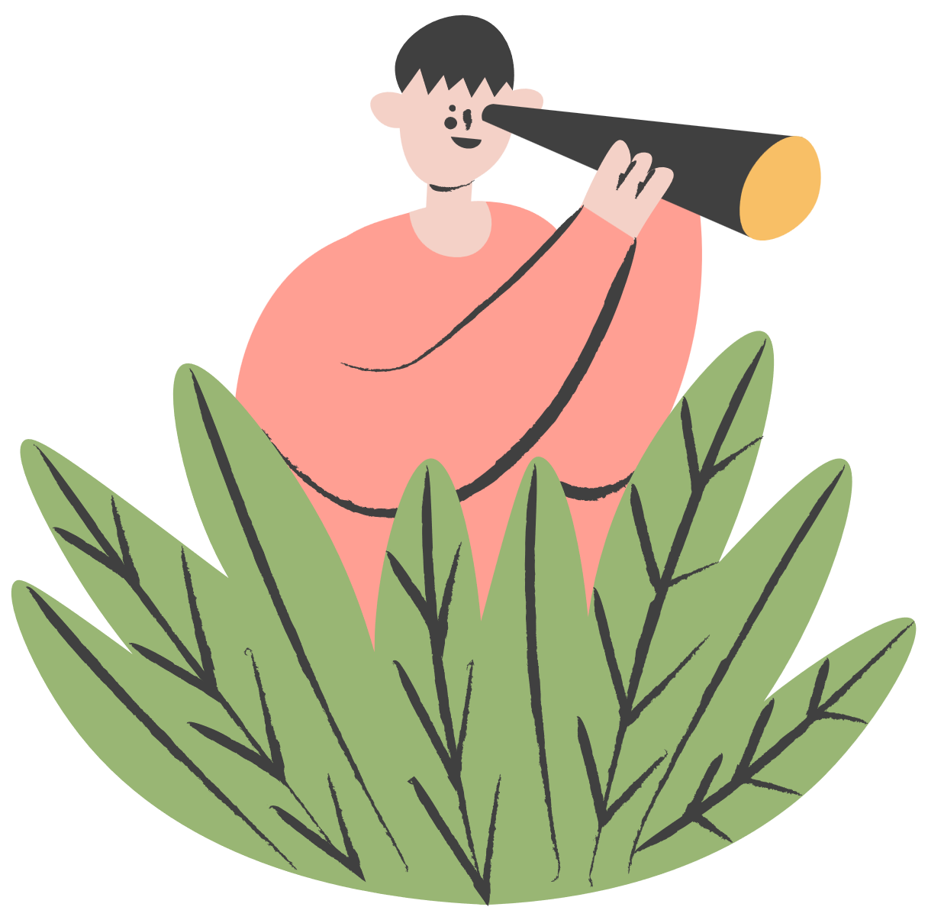

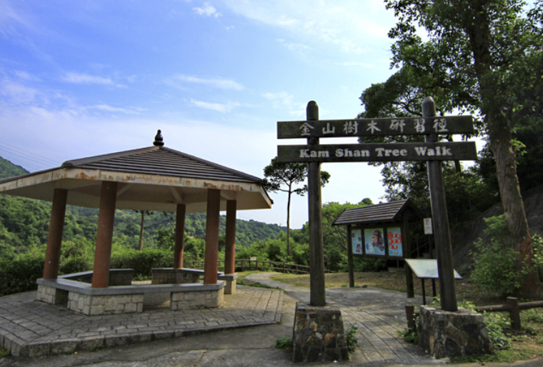
What is this place?
Primary 2
Enjoy Plastic-Free Countryside
Lead-in

Slide 3

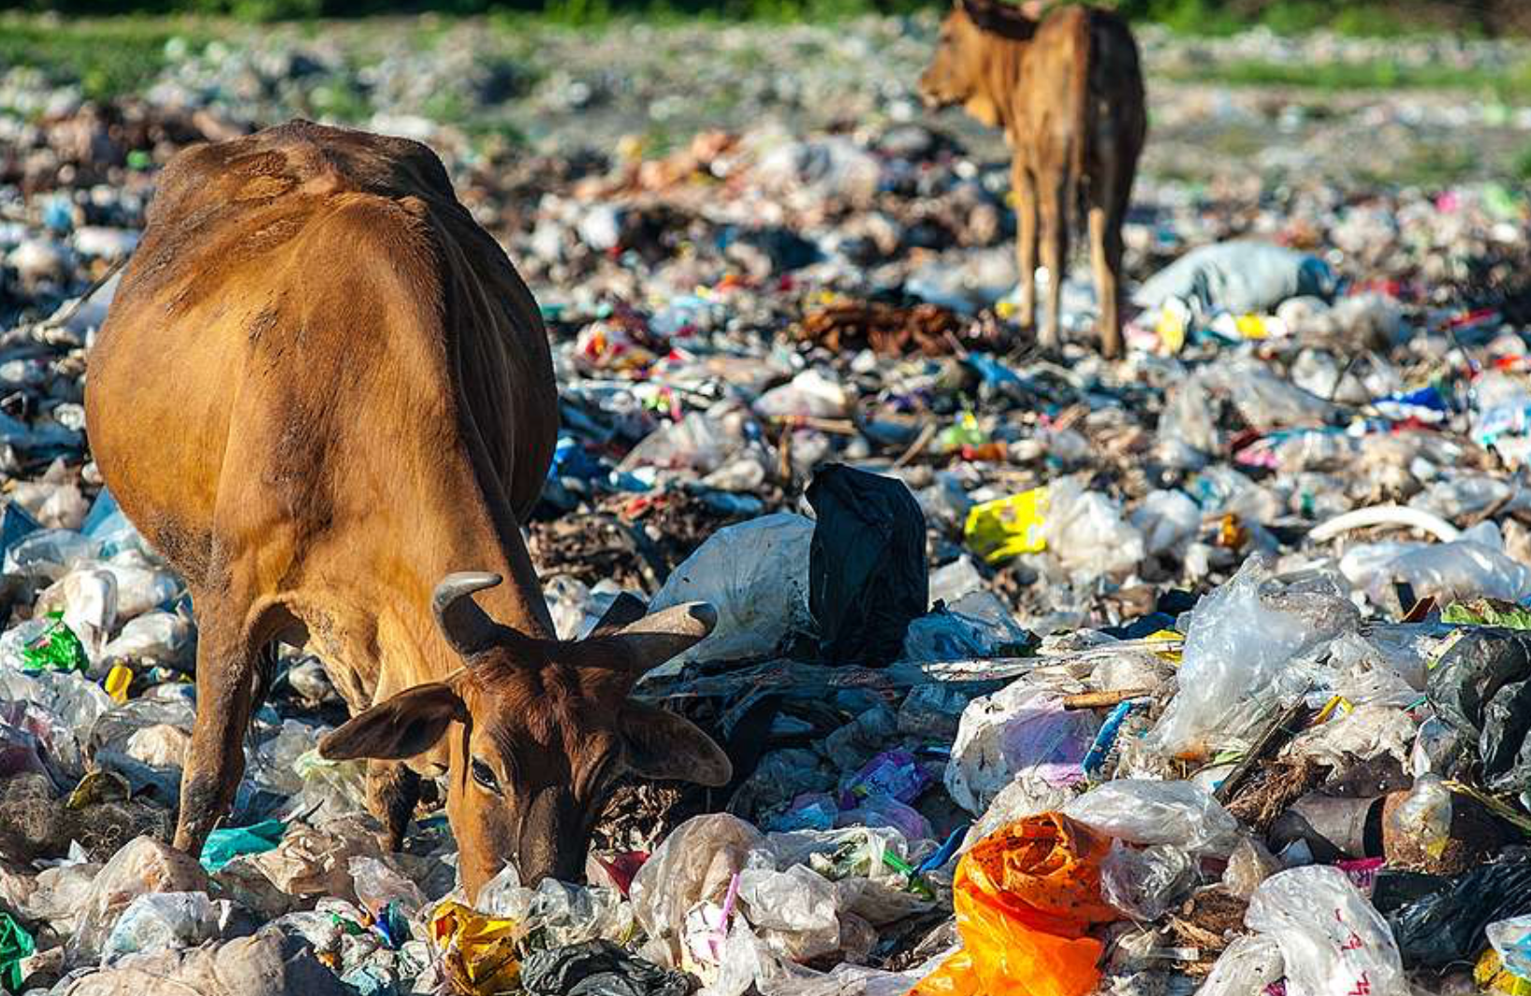
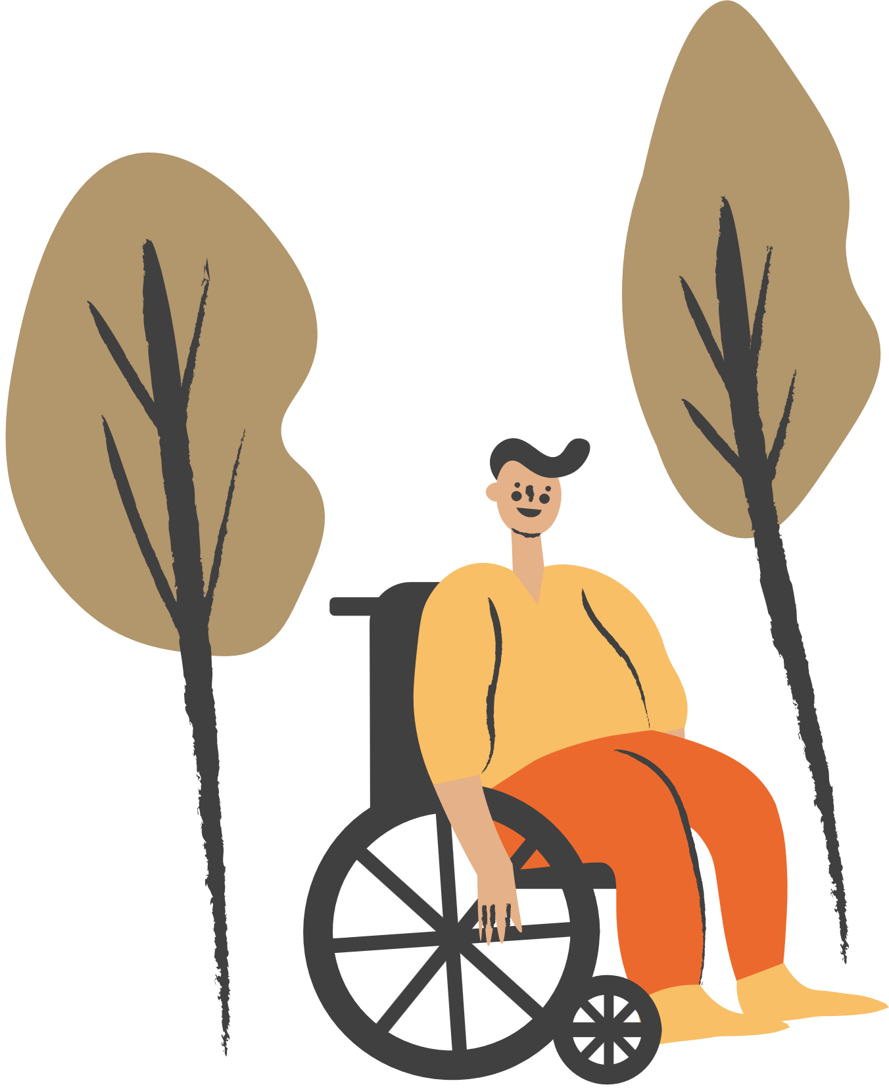
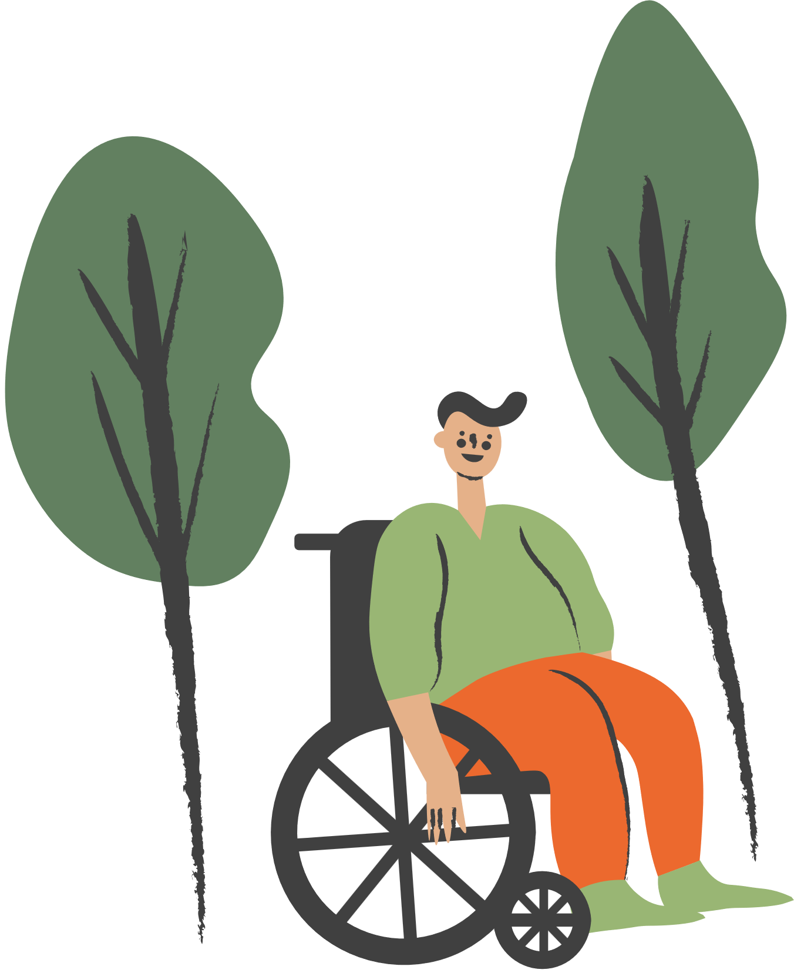
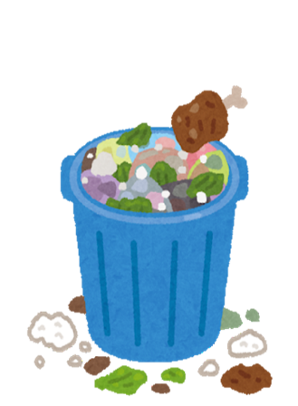


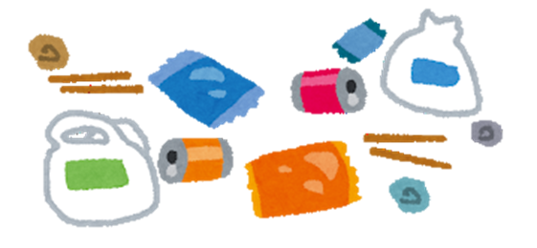
Impacts of plastic waste on the natural environment
Think about it
What is the brown cattle eating in the picture?
1
2
Why do these appear in the natural environment?

Slide 4
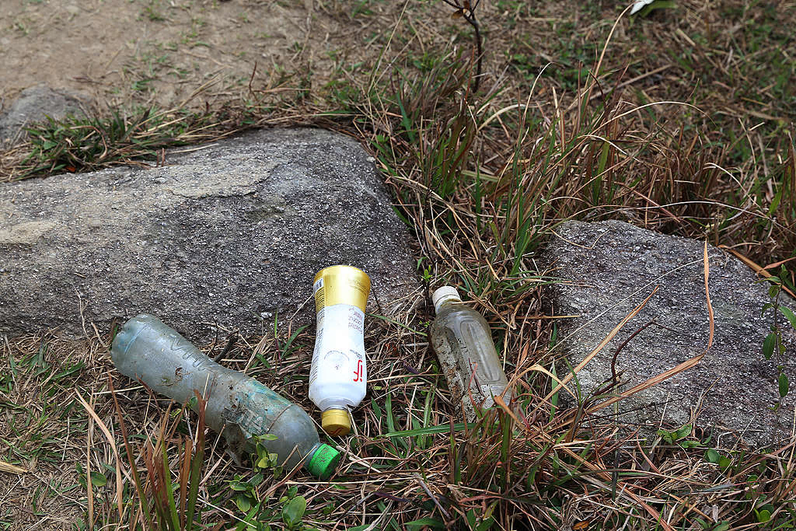
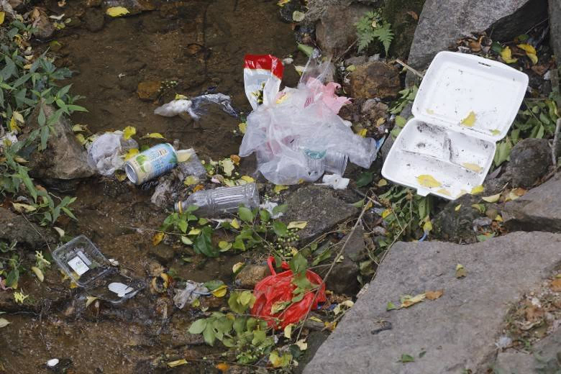
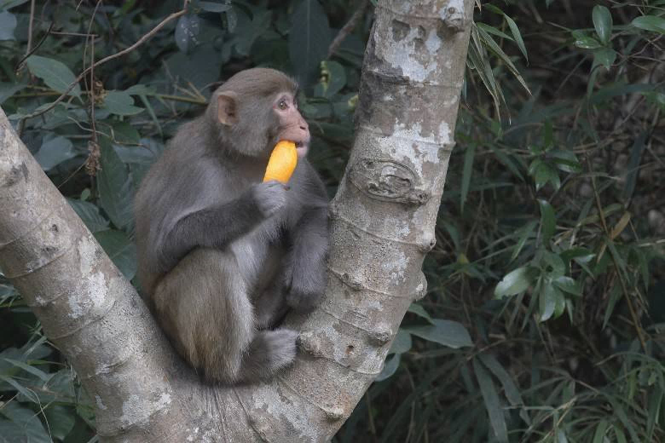
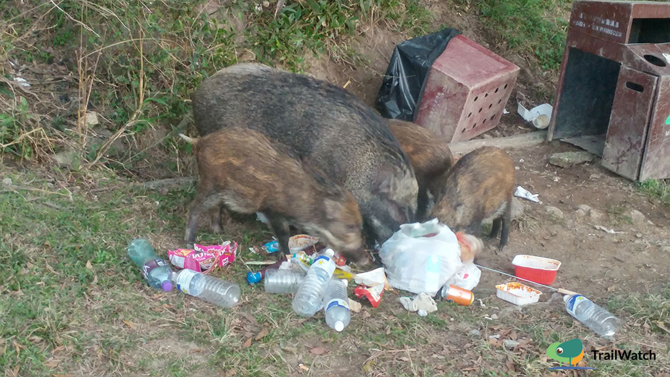
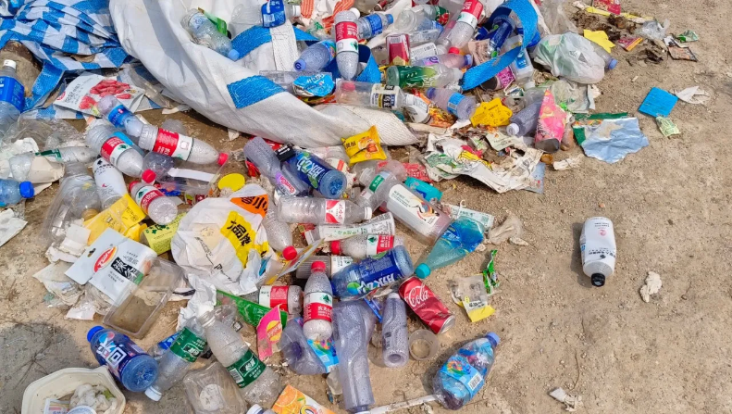
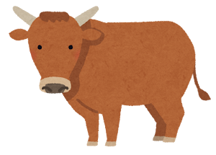


Impacts of plastic waste on the natural environment
Think about it
What kind of litter is in the natural environment?
What are the impacts of such litter on the environment and wild animals?
1
2

Slide 5
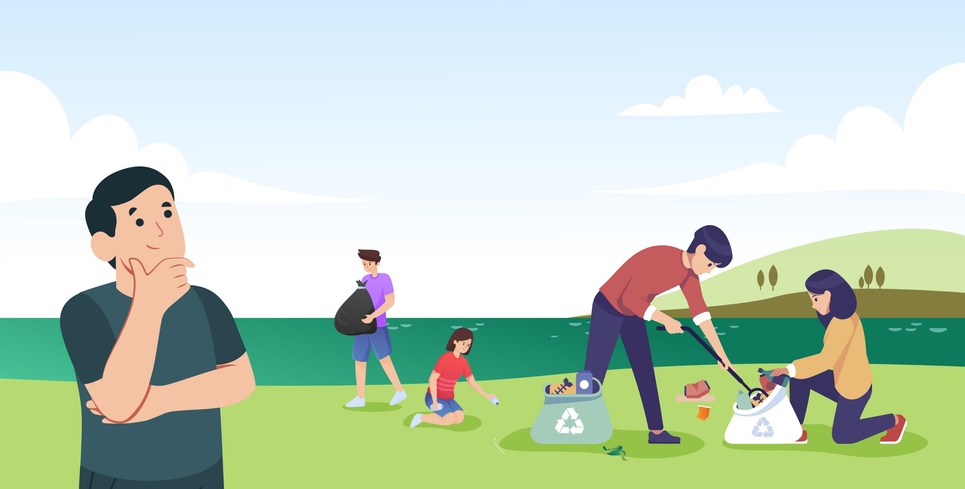

“Plastic-Free Countryside Activities” and “Take Your Litter Home”
Think about it
What are the ways to keep the countryside clean?

Slide 6
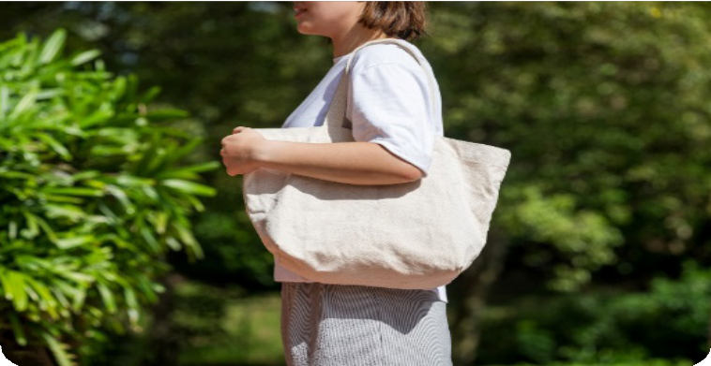
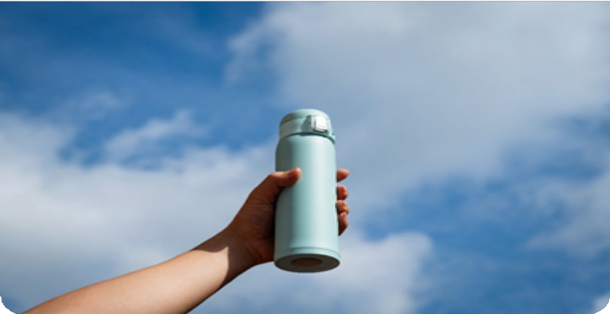
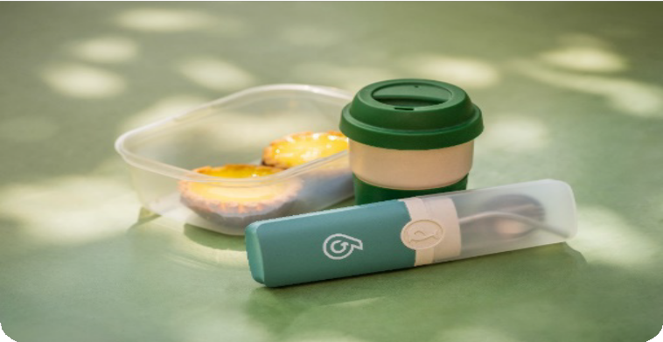
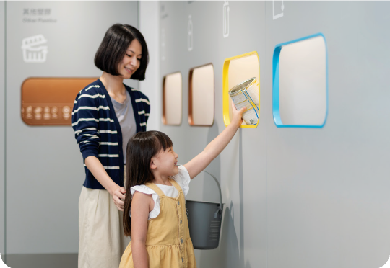

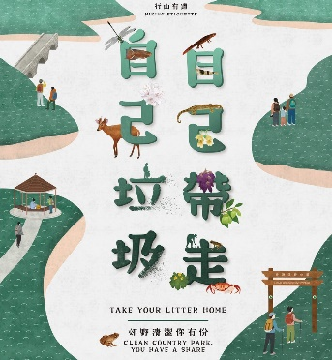
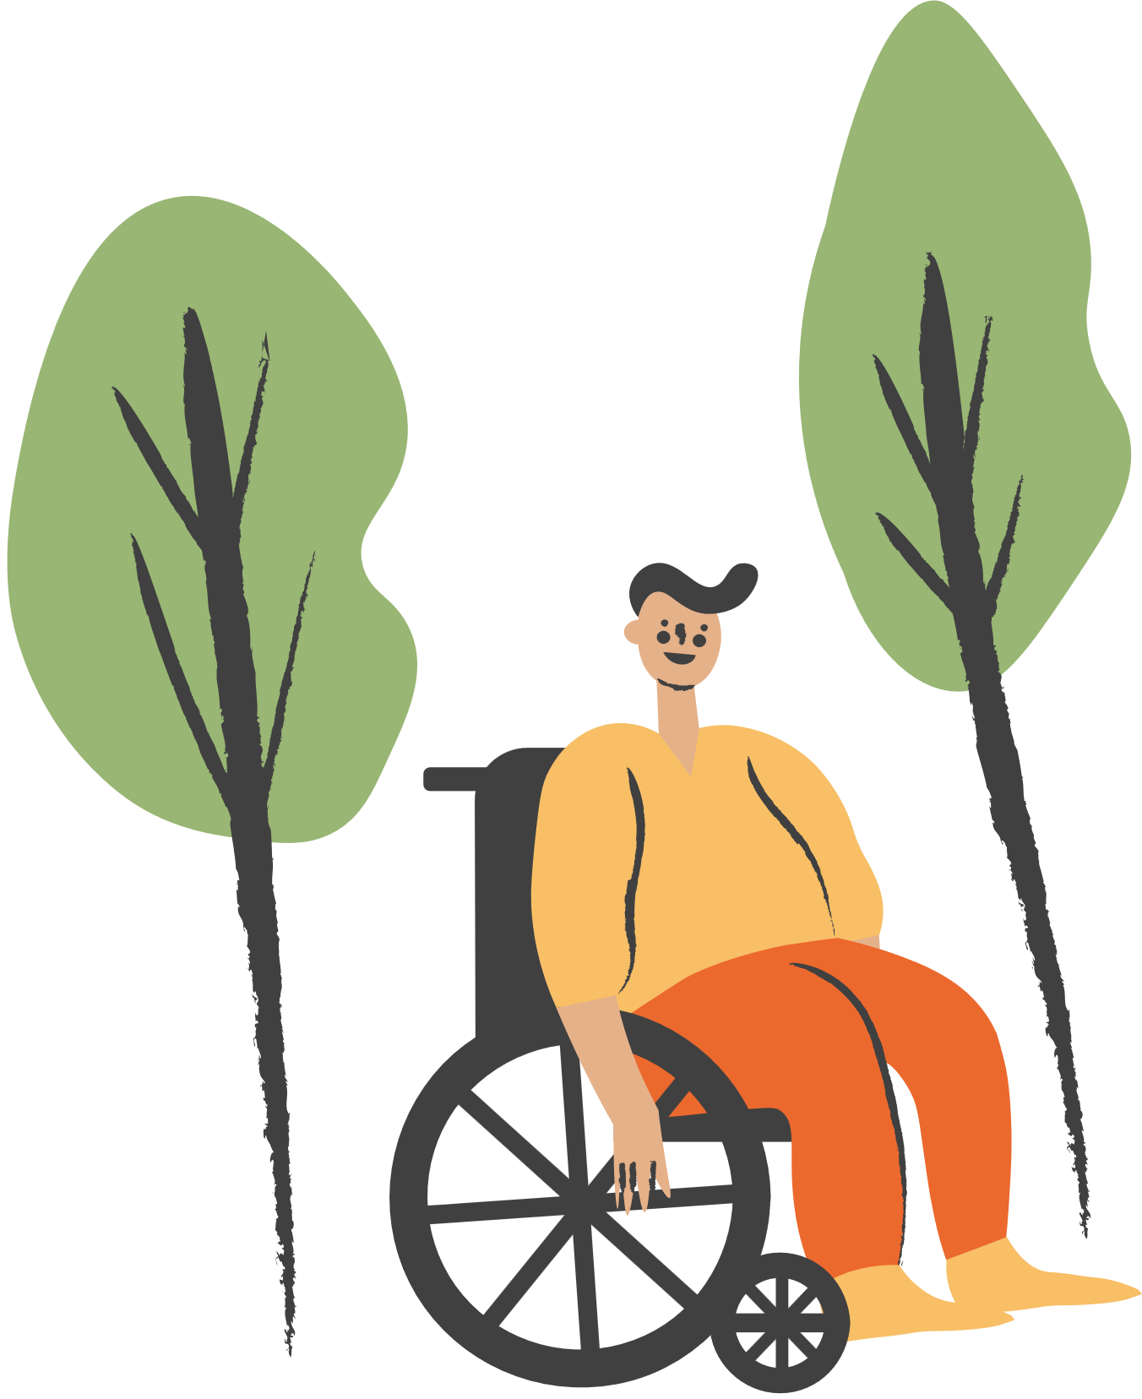
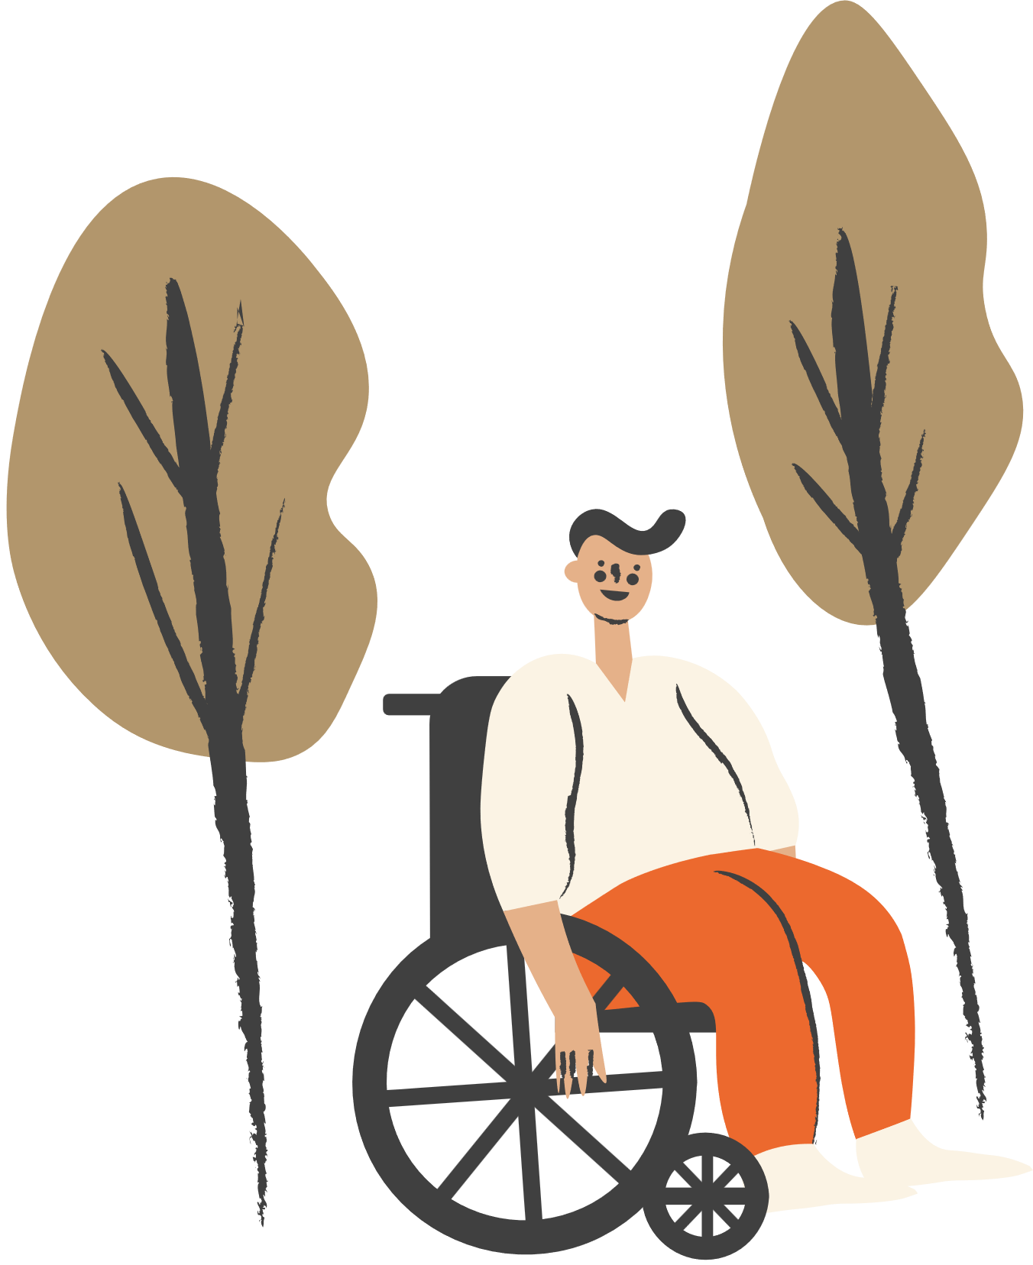


Ways to keep the countryside clean
Primary 2
1. Reducing the use of disposable items
2. Using reusable items
3. Preparing appropriate amount of food
4. Take Your Litter Home
5. Recycling
Notes:
Reducing the use of disposable items:
-Avoid using plastic bags, tissues, and buying over-packaging food
Using reusable items:
-Use reusable food containers and water bottles, replace tissues with towels, etc.
Preparing appropriate amount of food:
-Prepare food with appropriate portion to support the trip and some dry food or fruits as a reserve which can be taken away to avoid food wastage
Take Your Litter Home:
-Develop a good habit by taking your own trash with you after visiting country parks, and join together in protecting the natural environment
Recycling:
-Separate recyclables and put them into corresponding recycling bins

Slide 7



“Take Your Litter Home”
https://youtu.be/nBdjLZNuYvM?list=PL372xBQOMsf2SCYDVrP7dW8Oynws4EsOy

Slide 8
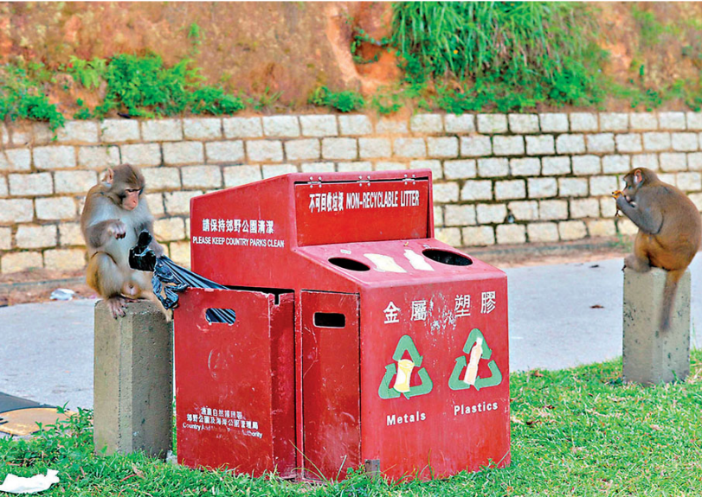
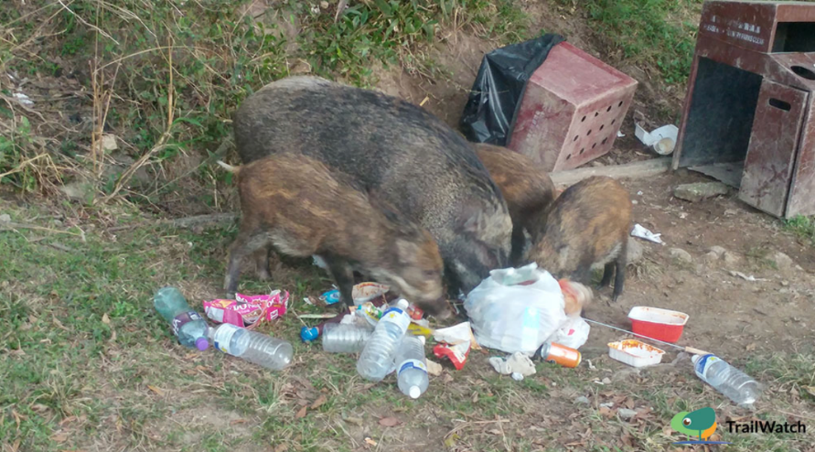
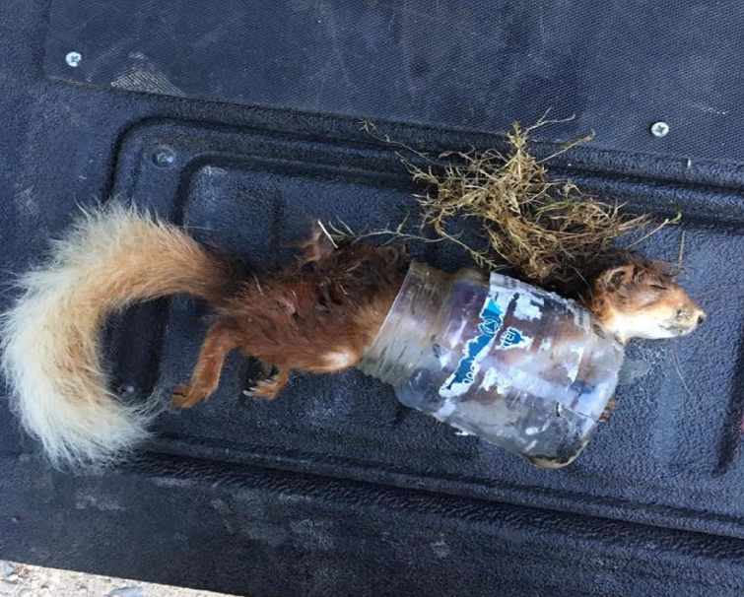

Building a sense of responsibility for keeping the countryside clean, and the attitudes and values towards animals protection
Think about it
Describe how the four scenarios in the picture threaten the health of wild animals or impact environmental hygiene

Slide 9



Building a sense of responsibility for keeping the countryside clean, and the attitudes and values towards animals protection
As human often leave behind leftover food while picnicking in the countryside, monkeys occasionally overturn litter bins, leading to scattered litter and affecting environmental hygiene

Slide 10
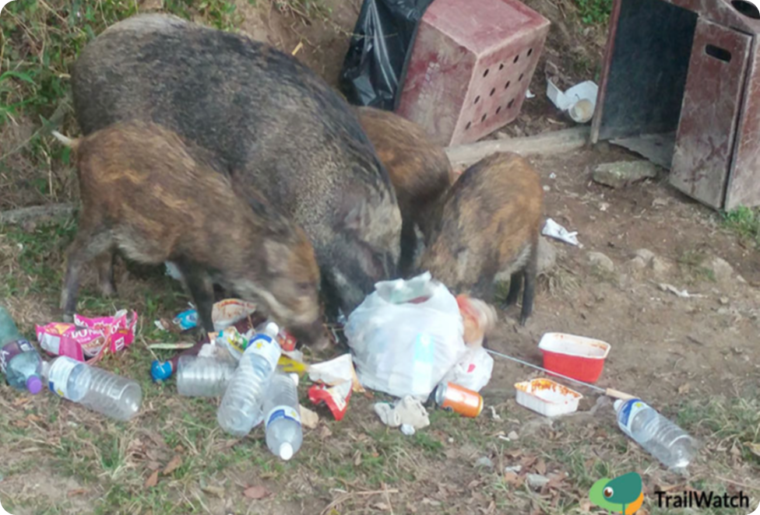
Building a sense of responsibility for keeping the countryside clean, and the attitudes and values towards animals protection
A family of wild boars eating food scraps near a litter bin may accidentally consume litter, potentially impacting the health of the animals

Slide 11
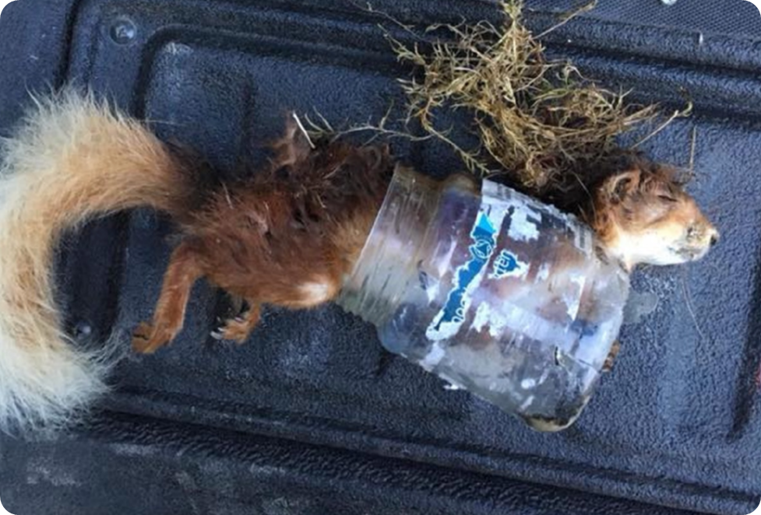

Building a sense of responsibility for keeping the countryside clean, and the attitudes and values towards animals protection
A squirrel trapped inside a plastic bottle may die due to the hindrance of its movement / foraging abilities

Slide 12
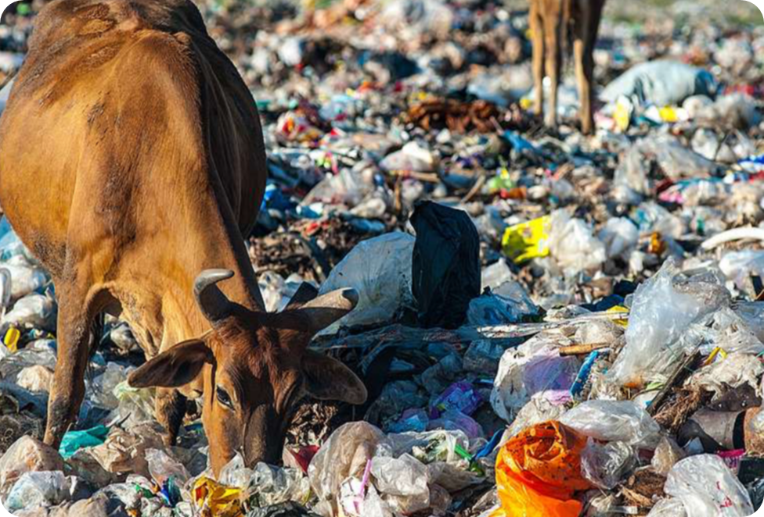
Building a sense of responsibility for keeping the countryside clean, and the attitudes and values towards animals protection
Brown cattle mistakenly consume plastic bags, potentially affecting their health and even leading to death

Slide 13
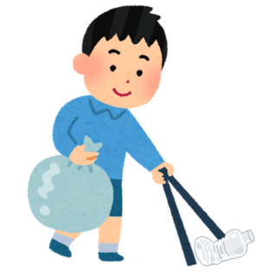
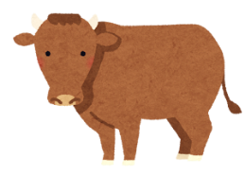


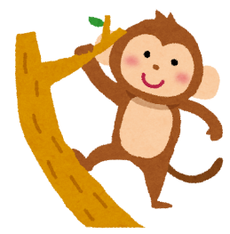
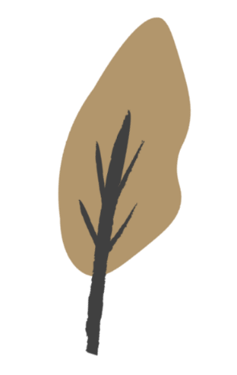


Poster design activity
Each group will be assigned a scenario to create a poster promoting the conservation of the countryside environment and wild animals

Slide 14
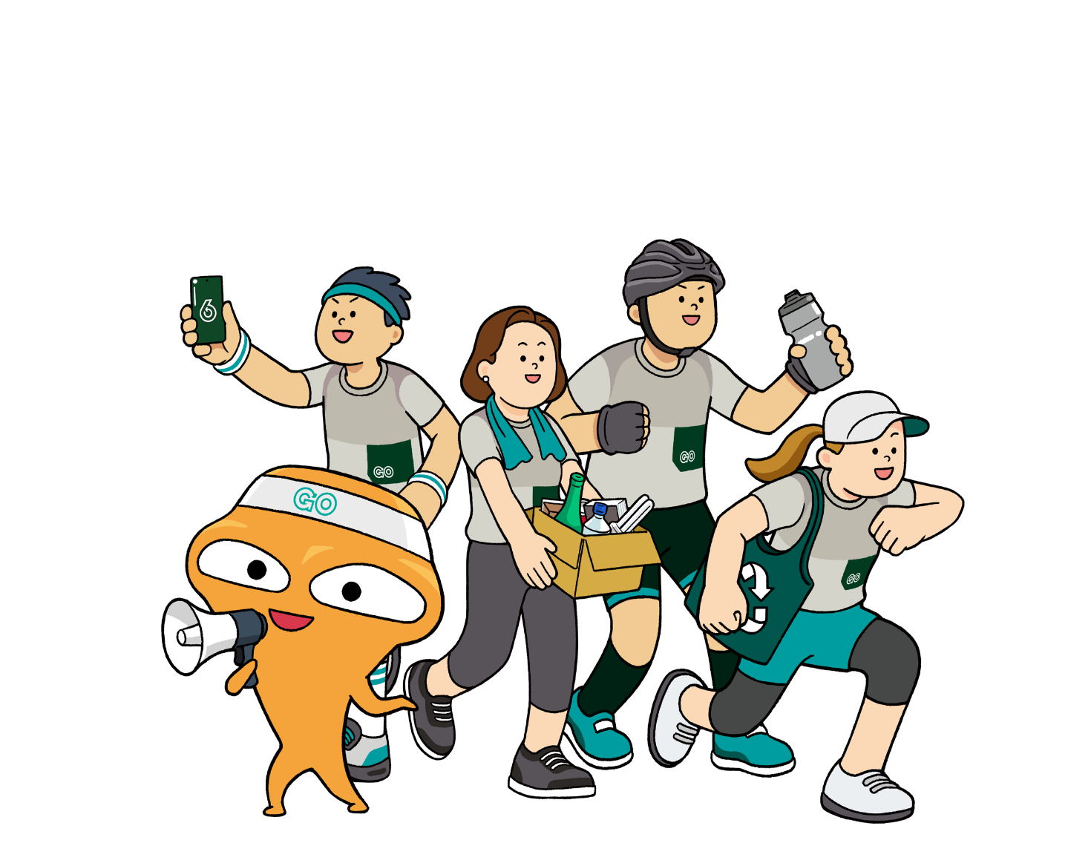
Conclusion
“Plastic-Free Countryside Activities” and “Take Your Litter Home”!
Let’s learn about waste reduction!
We should cherish the natural environment, keep the countryside clean, and protect wild animals
Before hiking, plan ahead and practice waste reduction at source
Remember to take recyclables with you for clean recycling during hiking

