Slide 1
Worksheet
Primary 3
07

Slide 2













Understanding about Clean Recycling
Student Worksheet
Name
Matching: Match the following situation with the
environmental principles by filling the corresponding letters in the circles below
Reduce
Replace
Reuse
Upcycling
Recycle
Situation
Environmental Principle
Example: No extra packaging for festival gifts
Writing or drawing on the blank space of another side of the paper
Replacing expanded polystyrene boxes with reusable food containers
Separating and putting recyclables into recycling bins
Making decorations from New Year's red packets
Avoiding the purchase or use of disposable items
True or false: Write “ ✓ ” for recyclables and “X” for non-recyclables
Common
domestic waste
Recyclables or
Common
domestic waste
Recyclables or
non-recyclables
non-recyclables
Photos
Milk cartons
Compact fluorescent lamps
Single-use batteries
Cardboards
Thermal paper
(e.g. supermarket receipts)
✓|X
Silicon (e.g. baby teats)
Fruit peels
Mooncake boxes
Sauce bottles
Fish tanks
Computers
Electric shavers
✓|X
7. Digital cameras

Slide 3

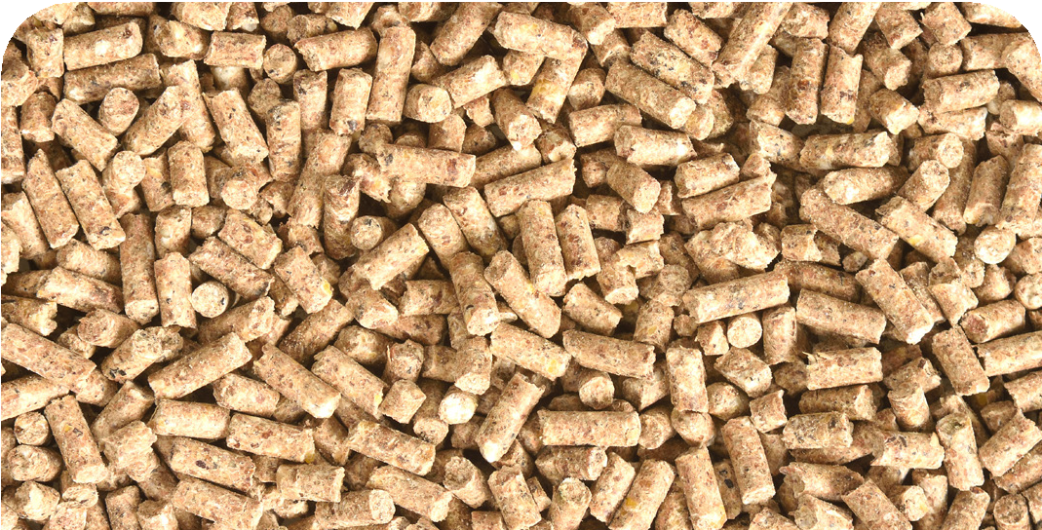
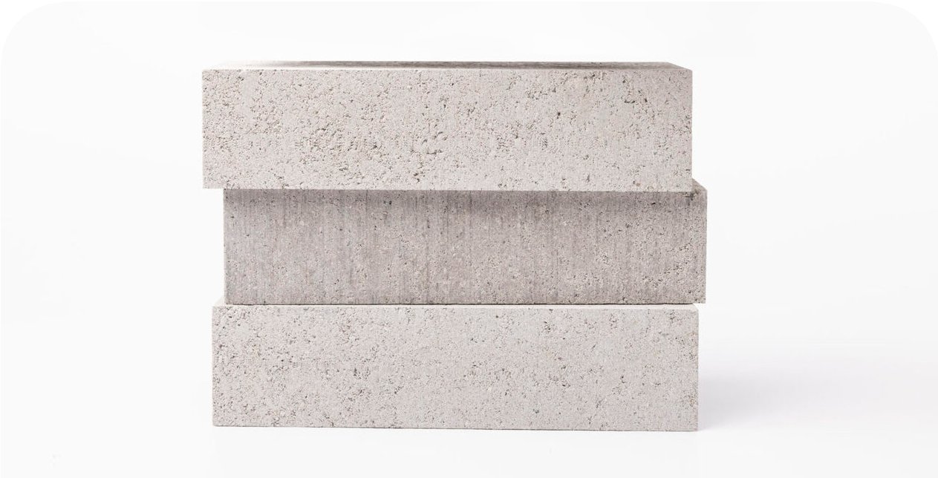
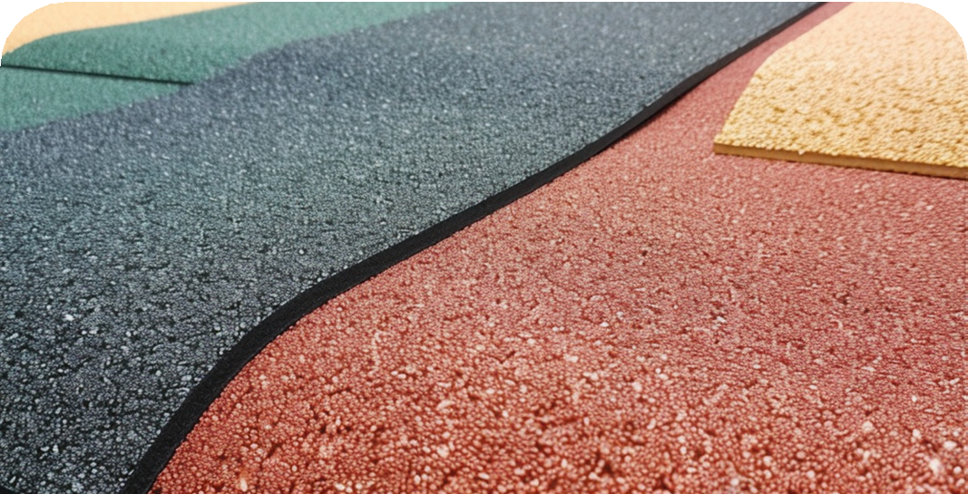
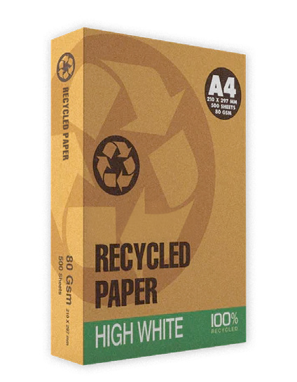

Matching: Match the following products with the corresponding recycled materials by filling the correct answers in the blanks
Plastics
Paper
Food waste
Glass bottles
Fish feed
Eco-bricks
Rubber tiles for playground
Recycled Papers
True or false: Write “ ✓ ” in the circles for a true statement and “X” for a false statement
Paper must be washed before recycling.
Books containing plastic tapes, paper clips, staples, etc. must be removed before recycling.
Plastic food containers must be rinsed and dried before recycling.
Suitcase is recyclable.
The plastic lids of milk cartons should be removed, and then emptied and rinsed before recycling
Place the uncleaned tin and aluminium cans directly into the recycling bin

Slide 4
Extended Activity Kit
Primary 3

Slide 5


Understanding about Clean Recycling
Extended Activity
Name
Reflection Worksheet
Which books or clothes did you exchange during the activity? Please describe the item(s) using drawings or text.
What did you learn from the activity?

Slide 6

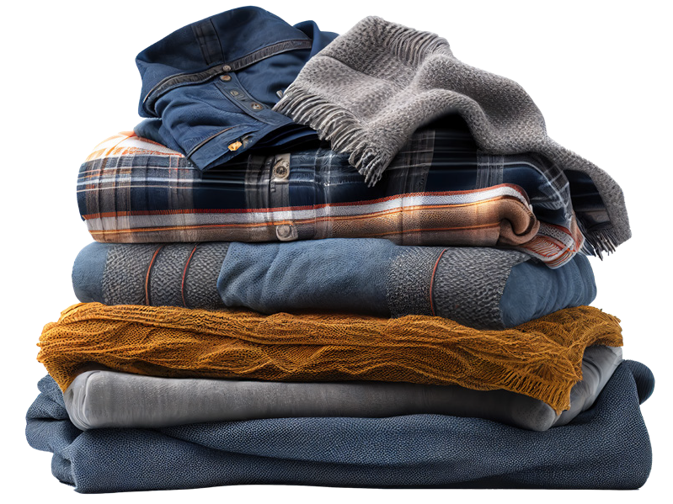



Understanding about Clean Recycling
Extended Activity
Activity Guidelines
Students can only bring books and clothes for exchange.
The books for exchange must be kept intact and without any noticeable stains. Students should ensure the content and condition of the books are suitable for exchange. The books must be genuine and at least 70% new. Books which are
yellowed, damaged, or with missing-pages are not accepted. Textbooks, exercise
books, dictionaries, magazines, journals, religious books, or outdated books (such as travel guides, fortune-telling books, etc.) are also not accepted.
Students must bring clothes that are washed, undamaged, and without any
noticeable stains. Students should ensure the quality and condition of the clothes are suitable for exchange. The clothes should be tops, pants, skirts, coats, and decorative accessories and must be at least 80% new. Any damaged or unclean clothes, school uniforms, uniforms, group outfits, shoes, socks, and intimate apparel like underwear
are not accepted.
Students can bring multiple items of clothes or books for exchange, and they can also freely select books or clothes donated by others. However, students should be courteous and take only what they need to ensure fair exchange opportunities.

Slide 7


Understanding about Clean Recycling
Extended Activity
Name
Interview Questionnaire
Script for interview: Hi, I am a P.3 student of xxx Primary School. My name is xxxx (Student’ English Name). I have just observed the recycling procedures with my parents, and I wish to know more about the recycling habit of the public. Would you mind to spend 5 minutes with me for an interview?
How do you separate and handle recyclables in your daily life?
What difficulties do you encounter in your daily recycling process?

Slide 8

Do you separate your recyclables with clean recycling?
How often do you participate in recycling in each week? Will you
encourage you relatives or friends to participate in recycling together?

